Slide 1

START

Slide 2

Notes:
Delete this slide when you finish preparing the other slides.

Slide 3

Object-oriented programing
Project
Hospital Management System
<BSCS-G-Section>
TEACHER: MA’AM AMINA SAUD
Presented by
Muhammad Azeem
Muhammad Maaz Usman
Osman Asgher
Umer Farooq

Slide 4
Table Of Contents
Introduction
Why have I chosen it
What have I learnt from doing project
Features
Program Circle
Demo (Execution of Project)
Question and Answer session

Slide 5
Introduction
The project Hospital Management system includes registration of patients, storing their information into the system with the help of File handling and it can also be used by pharmacy, labs and Vending Machine. The Software has the facility to give a unique id for every patient, stores, vending machine, and All Staff. The details of every patient and the staff are saved automatically. The Hospital Management System can be entered using a username and password (GUI) as well as Pharmacy, Lab, Vending machine. Receptionists can manage All Doctors, Nurses, and workers Timetable and Accountant can manage all salaries. In this project, there is a small Bank system in the software and all the revenue is saved in Bank.

Slide 6
WHY I HAVE CHOSEN IT
Because of Covid-19
Proposed system
This system will be most useful for searching the details of Doctors, and Patients
Manage Doctor time, salaries, department, and Unique ID as well as Nurses and workers

Slide 7
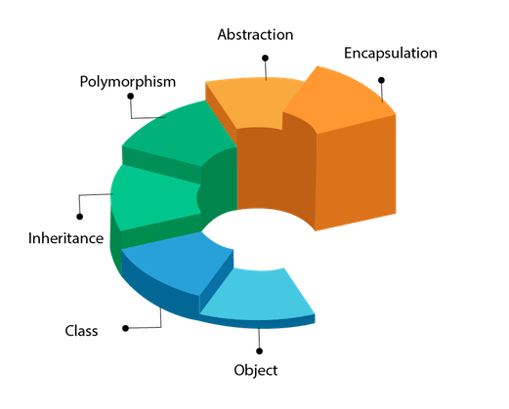
WHAT HAVE I LEARNT FROM DOING PROJECT
While doing Java Object Oriented Programming semester project I have learnt following respective things.
Important Object Oriented concepts
Inheritance
Polymorphism
Encapsulation
Implementation
Abstract classes & Interfaces
Exception Handling
File Handling
Graphical interface Design

Slide 8
FEATURES OF MY PROJECT
Use GitHub
FEATURES
Update Data
in All File
Search Data in All File
Delete Data
in All File
View Data
in All File
Small Bank, Vending, and Stock System
Search Doctor with current Time
Use 3 interface To control all program
Accountant maintain all Staff Salaries
Pharmacy record and maintain Stock

Slide 9
Program Circle
Hospital Management System
All Departments
Utility Bills
Pharmacy
Doctors Salaries
Bank
Lab Test
Worker Salaries
Patient
Nurses Salaries
Vending Machine
Profit

Slide 10
Corona Dept.
Doctors Timetable
Eye Dept.
Patient Record
Receptionist
Cancer Dept.
Dept. Record
General Dept.
Worker Record
Operation Dept.
Nurses Record
Cardiac Dept,
Doctors Record

Slide 11
Pharmacy
Stock Record
Manager
Lab
Mange Quantity
Vending Machine
Unique ID

Slide 12
Project development Tools
Eclipse
MS Word
PowerPoint
Git Hub (Communication)
Smart Git
Git (Commands)

Slide 13
Program Information
Total Classes = 35 Total Functions = 165 Total Lines = 13K
Main Body Hint = if ( while (switch (While (if (switch ( ))))).

Slide 14


Slide 15
I would like to express my special thanks to my teacher (Amina Saud & Zunair Mahmood) who gave me the golden opportunity to do this wonderful project on the topic (Hospital Management System), which also helped me in doing a lot of learning and I came to know about so many new things I am really thankful to them. Secondly, I would also like to thank Group Members who helped me a lot in finalizing this project within the limited time frame.
Thank you !

Slide 16


Slide 17


